Slide 1
PROJECT TITLE-PREDICTION OF LOAN ELIGIBILITY COURSE NAME-DATA ANALYTICS BATCH CODE-2021-6780
Email id:- ashishkushwah083@gmail.com
Presented by :- Ashish Kushwah

Slide 2
Q. What is loan prediction?
Loan Prediction system is a system which provides you a interface for loan approval to the applicants application of loan. Applicants provides the system about their personal information and according to their information system gives his status of availability of loan.

Slide 3
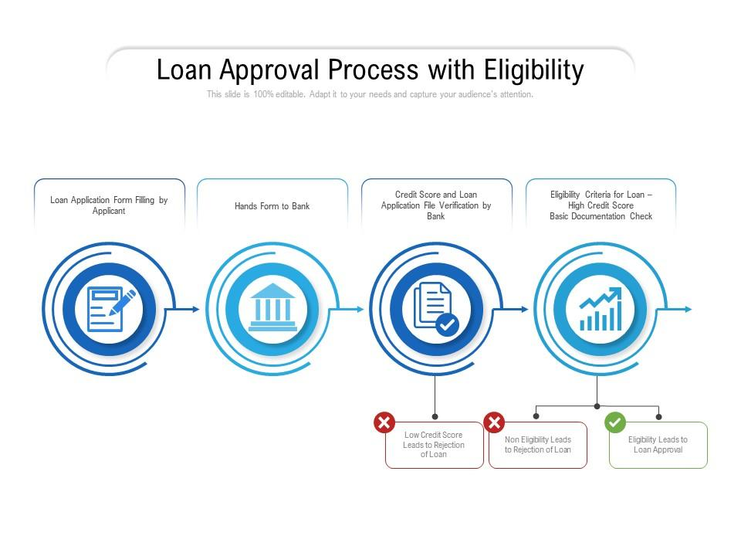

Slide 4
Objectives
Mainly two objective
Identification of relevant attributes
Determining the best model

Slide 5
TOOLS USED
Language used - Python
Software - Jupyter
Process used - Exploratory Data Analysis (EDA)
- Visualization
-Machine learning

Slide 6
Add your link to show your coding -:
https:/python.code

Slide 7


